Slide 1
A Modular GCD Algorithm
By Anna, Bernhard and David

Slide 2
Outline
Basics
Modular GCD of Integers
Modular GCD of Polynomials

Slide 3
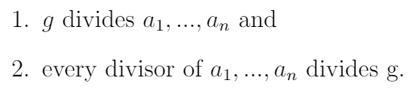

Basics in GCD Computations
GCD g of non zero elements
Euclid’s algorithm
Bèzout cofactors

Slide 4
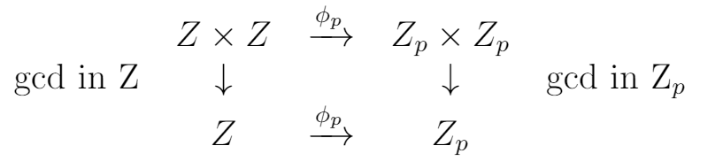
Modular GCD
ɸp is homomorphism function
Steps:
Select primes - Unlucky primes
computed result is not the gcd
example: a(x) = x - 3, b(x) = x + 2, gcd(a, b) = 1, mod 5 : gcd(a, b) = x + 2
Convert a and b to modular representation
Reduction loop
Return result in standard representation

Slide 5
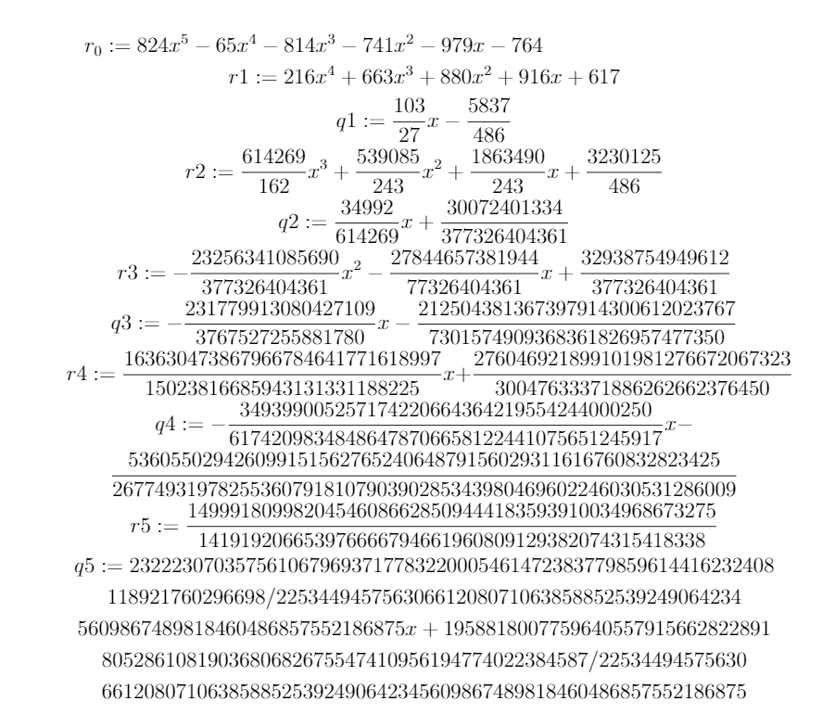
Large growing coefficients
Problem: Coefficients are growing to large number while computing the GCD
Solutions:
monic after each reduction, but needs extra GCD computations
or...

Slide 6
Motivation
Modular GCD computation with...
… Polynomials:
eliminated risk of large growing coefficients
… Integers:
more efficient and much faster than the original representation
arithmetic operations can be performed on parallel processors

